Slide 1
EcoSLIM
Princeton GPU Hackathon
Members
Jun Zhang, The University of Arizona
Hoang Tran, Princeton University
Chen Yang, Princeton University
Mentors
Troy Comi, Princeton University
Carl Ponder, NVIDIA

Slide 2
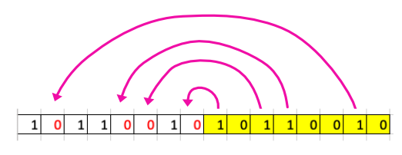
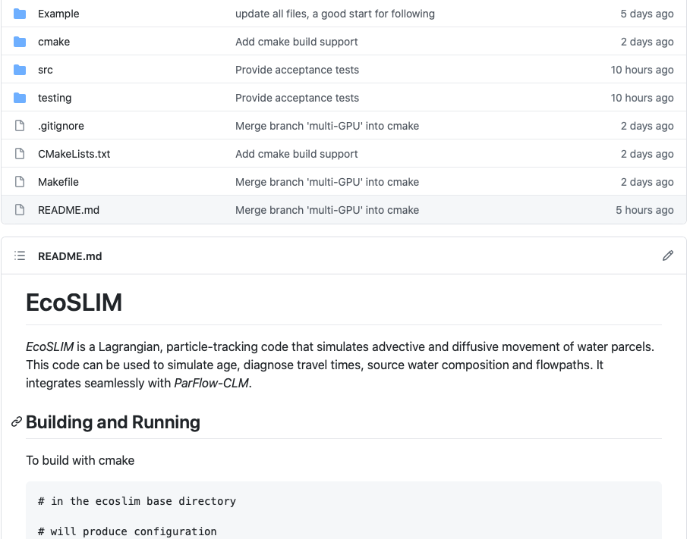
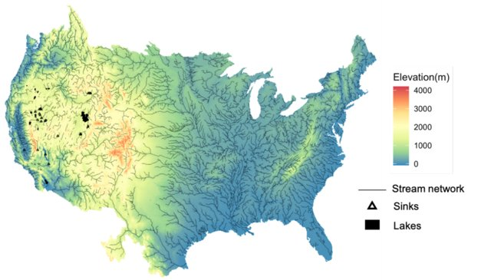
Progress and Goals
What have you accomplished since June 8?
Fixed the race condition by splitting the compaction
kernel to two.
Tested the serial code and the updated parallel
code for different number of particles
Tested the code with MPI
Used cmake and figured out the new structure
of the whole code.
What are your goals for the day?
Use Nsight to profile the code
Work with Troy for refactoring code
Present the new structure of the whole code
In-place compaction

Slide 3
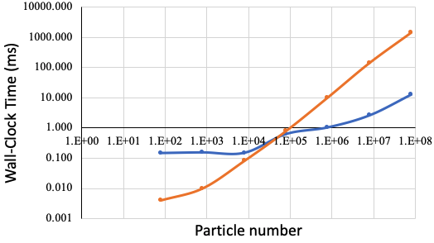
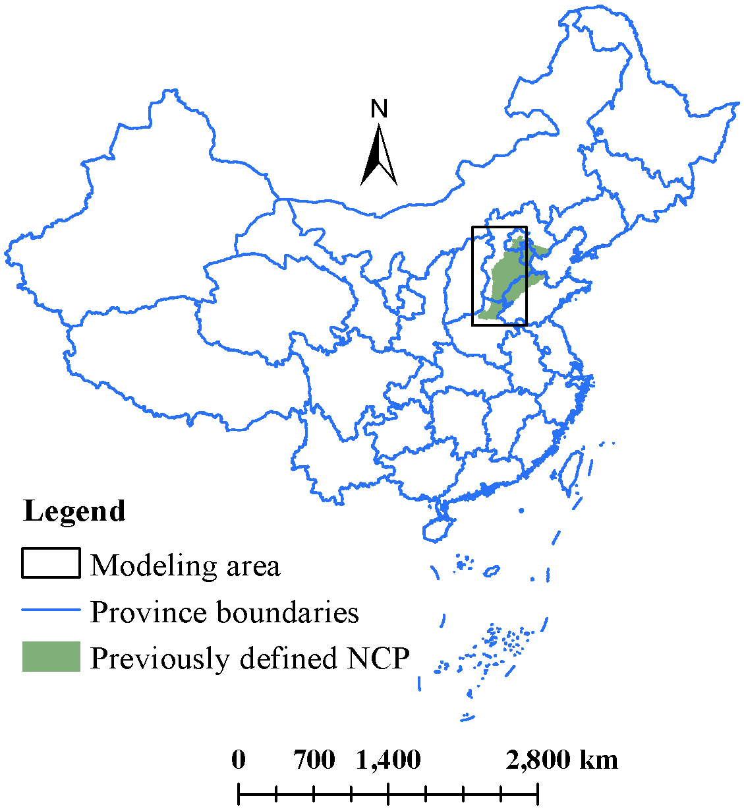
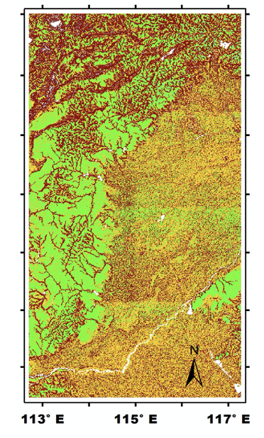
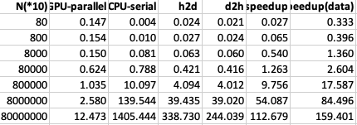
The test results using an array of size 80,000,000*10 for serial and parallel codes:
a. the parallel code used 12.473 ms, the serial code used 1405.444 ms, so the speedup is 112-fold b. considering transfer data, speedup is 159-fold
CPU
GPU
Long term simulation of 40 years with hourly time step
1s*8760*40/3600/24 = 4 days wall-clock time saved

Slide 4
Problems and Solutions
What problems are you currently facing?
Have you resolved any problems (or found bugs) that others might find useful?

